Slide 1
Software Requirement Engineering
CSE-305
Dr Ghulam Rasool

Slide 2
Requirements Analysis
The aim of requirements analysis is to discover problems with the system requirements, especially incompleteness and inconsistencies
Analysis is inter-leaved with requirements elicitation as problems are sometimes obvious as soon as a requirement is expressed
Detailed analysis usually takes place after the initial draft of the requirements document is produced
Analysis is concerned with incomplete set of requirements, which has not been discussed by stakeholders

Slide 3
Requirement Analysis
Requirement
Elicitation
Requirement
Analysis
Requirement
Specification
Software Architecture

Slide 4
Iterative Aspects of Elicitation, Analysis, and Negotiation
Draft
Statement of
Requirements
Requirements
Elicitation
Requirements
Analysis
Requirements
Documents
Requirements
Problems
Requirements
Negotiation

Slide 5
Problems of Requirement Analysis
Stakeholders don’t know what they really want.
Stakeholders express requirements in their own terms.
Different stakeholders may have conflicting requirements.
Organisational and political factors may influence the system requirements.
The requirements change during the analysis process. New stakeholders may emerge and the business environment change

Slide 6
Requirements Analysis Process
Necessity
checking
Consistency and
completeness
checking
Feasibility
checking
Conflicting and
incomplete
requirements
Unnecessary
requirements
Infeasible
requirements

Slide 7
Necessity Checking
The need for the requirement is analyzed. In some cases, requirements may be proposed which don’t contribute to the business goals of the organization or to the specific problem to be addressed by the system

Slide 8
Consistency and Completeness Checking
The requirements are cross-checked for consistency and completeness. Consistency means that no requirements should be contradictory; Completeness means that no services or constraints which are needed have been missed out

Slide 9
Feasibility Checking
The requirements are checked to ensure that they are feasible in the context of the budget and schedule available for the system development

Slide 10
Examples
The system shall play the sound ’alarm’ when the door is opened.[incomplete]
When a user has entered the building, this shall be registered in the entry log and the user’s computer shall be booted.[Amalgamation]
The system shall respond very quickly to user queries
System must monitor all temperatures in a chemical reactor.
System should only monitor and log temperatures below -200 C and above 4000 C. [Inconsistent]
System has to be bug free[unvarifiable]
The system shall work just like the previous one, but on a new platform

Slide 11
Examples
The Internet User quickly sees her current account balance on the laptop screen.(Bad)
The Online Banking System shall allow the Internet user to access her current account balance in less than 5 seconds.(Good)
The system shall use Microsoft Outlook to send an email to the customer with the purchase confirmation.(Bad)
The system shall inform the customer that the purchase is confirmed(Good)

Slide 12
Requirement Analysis Techniques
Goal Oriented Analysis
Business goals, Stakeholder goals
Model requirements
UML models, Formal models (e.g., Z-notations)
Draw context diagram and detail diagrams
E.g., DFDs, ERD
Create prototypes
Evolutionary, Throwaway, Simulations (Telecom solution), Experimentations (Machine learning and data mining solutions)
Analyze feasibility
Cost, Time, Technologies
Prioritize requirements
AHP, hundred dollar
Create data dictionary
Glossaries, meta-data (input values, range of values, data format, output values)
Decision Trees and Decision Tables
Allocate requirements to subsystems
Modularization
Analysis checklists
Based on experiences in previous projects (Covered in previous slides)
Requirements Interactions
Traceability metrics

Slide 13
Model requirements
Data model
shows relationships among system objects
DFDs, ERD
Functional model
description of the functions that enable the transformations of system objects
State diagram
Behavioral model
manner in which software responds to events from the outside world
Interaction Diagram

Slide 14
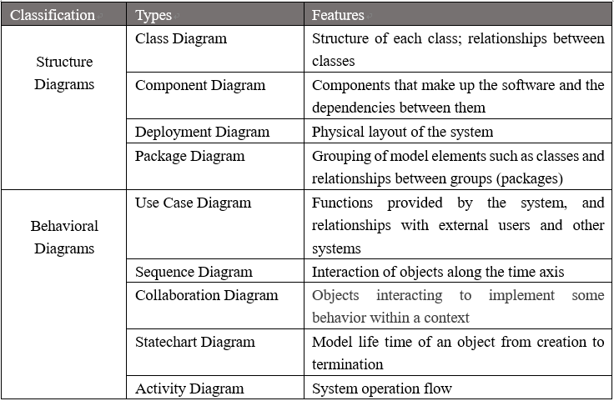
Model Requirements

Slide 15
Modeling Methods
Structured Analysis
Abstraction and Modularity
Object-Oriented Analysis
Formal Methods
Using predicate calculus (MCRL2) and set theory (Z-notations)
Visual depictions (Petri-nets)

Slide 16
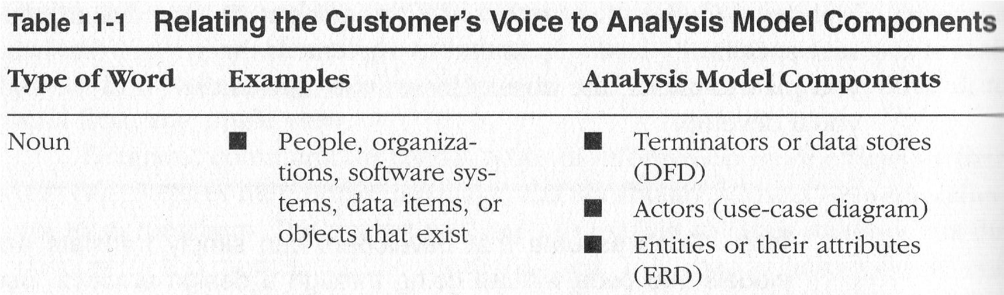
Analyze Requirements

Slide 17
Data Flow Diagrams
Data flow diagramming shows business processes and the data that flows between them

Slide 18
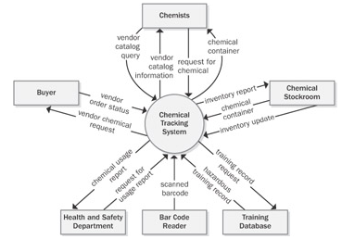
Context DFD

Slide 19
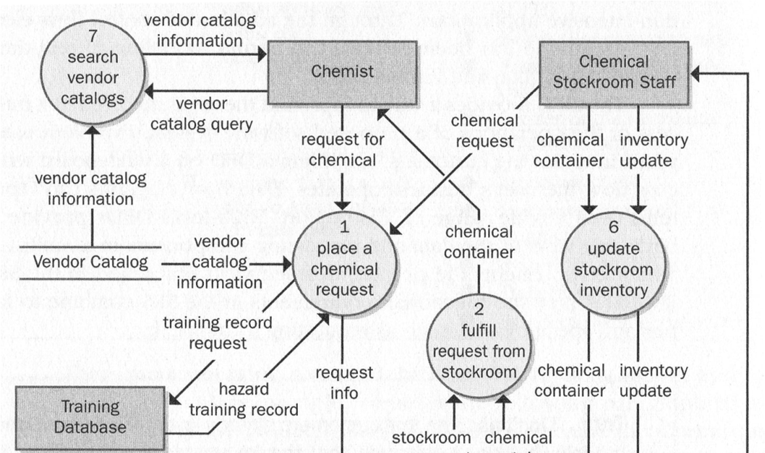
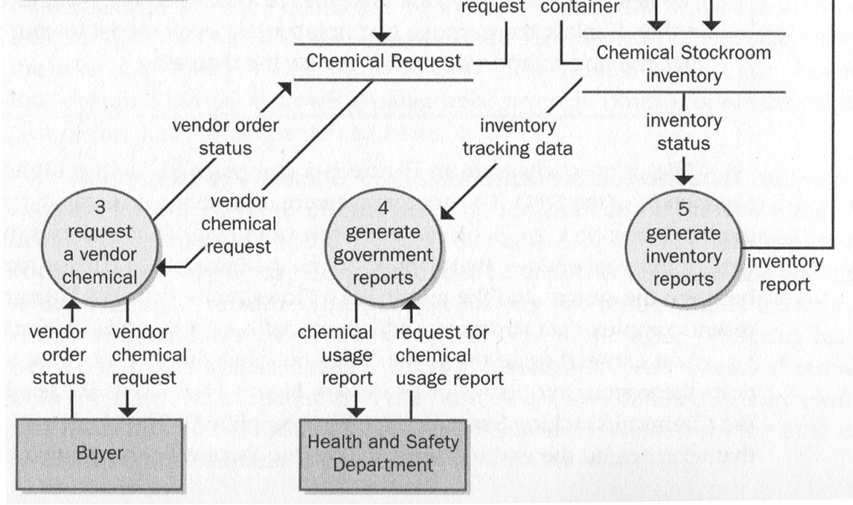
Data Flow Diagram

Slide 20
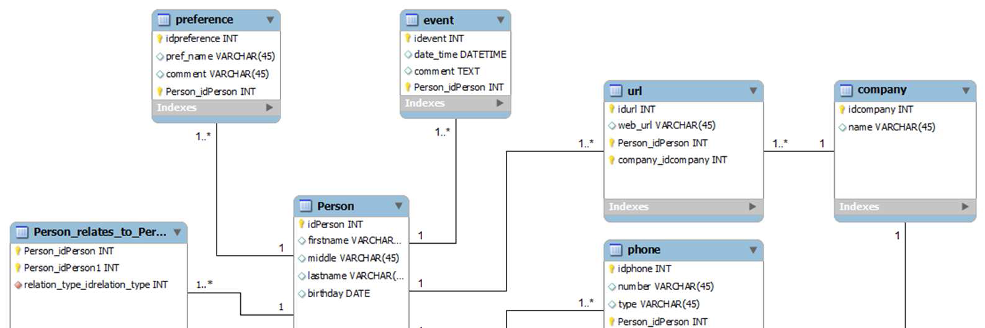
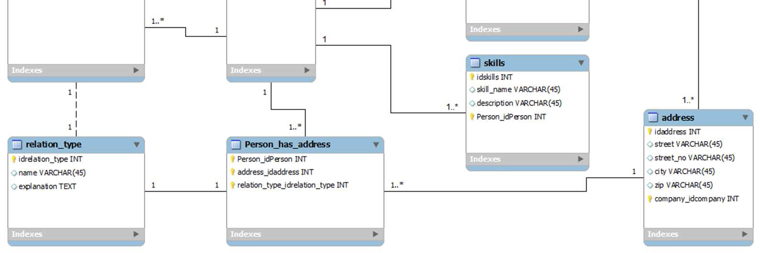
Entity Relationship Diagram

Slide 21
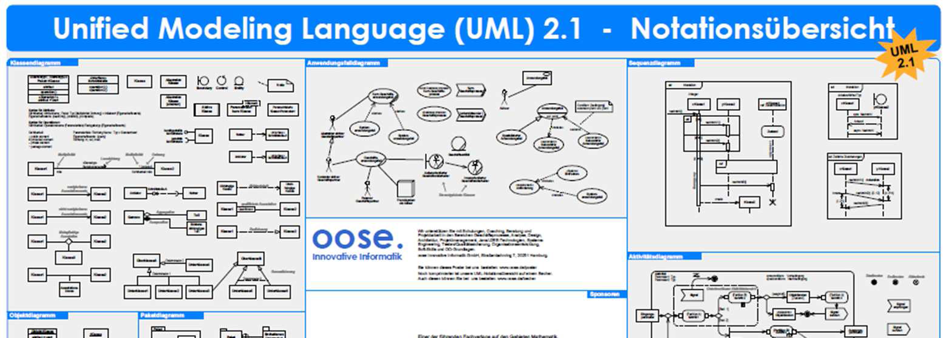
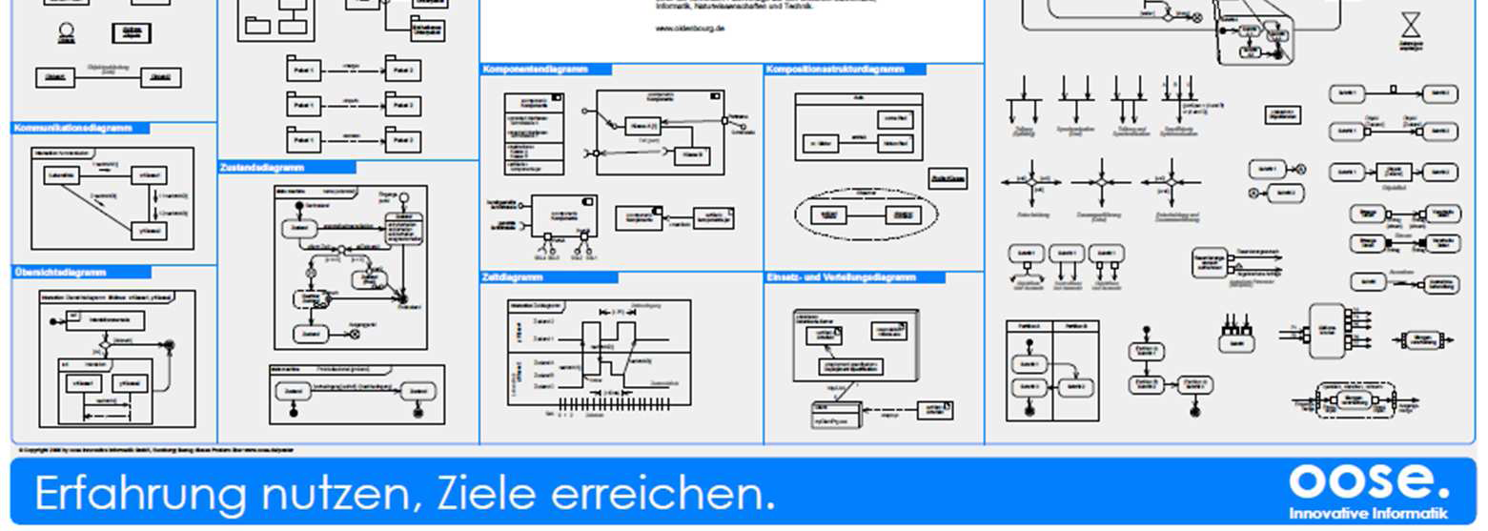
UML

Slide 22
Requirement Analysis Outsourcing
Outsource2India has had over 10 years of experience working on software projects of varying scopes.
www.outsource2india.com

Slide 23
Requirements Interactions
An important objective of requirements analysis is to discover the interactions between requirements and to highlight requirements conflicts and overlaps
A requirements interaction matrix shows how requirements interact with each other, which can be constructed using a spreadsheet
Each requirement is compared with other requirements, and the matrix is filled as follows:
For requirements which conflict, fill in a 1
For requirements which overlap, fill in a 1000
For requirements which are independent, fill in a 0

Slide 24
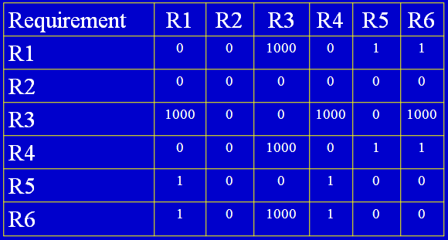
An Interaction Matrix

Slide 25
Requirements Negotiations
Disagreements about requirements are inevitable when a system has many stakeholders. Conflicts are not ‘failures’ but reflect different stakeholder needs and priorities
Requirements negotiation is the process of discussing requirements conflicts and reaching a compromise that all stakeholders can agree to
In planning a requirements engineering process, it is important to leave enough time for negotiation. Finding an acceptable compromise can be time-consuming
The final requirements will always be a compromise

Slide 26
Requirements Negotiation Stages
Requirements discussion
Requirements which have been highlighted as problematic are discussed and the stakeholders involved present their views about the requirements
Requirements prioritization
Disputed requirements are prioritized to identify critical requirements and to help the decision making process
Requirements agreement
Solutions to the requirements problems are identified and a compromised set of requirements are reached. Generally, this will involve making changes to some of the requirements

Slide 27
Requirements Negotiation Process
Unnecessary
requirements
Conflicting and
incomplete
requirements
Infeasible
requirements
Requirements
discussion
Requirements
prioritization
Requirements
agreement
Requirements Negotiation

Slide 28
Resolution of Requirements Conflicts
Meetings are the most effective way to negotiate requirements and resolve requirements conflicts
All requirements which are in conflict should be discussed individually
Negotiation meetings should be conducted in three stages

Slide 29
Stages of Negotiation Meetings
Information stage
An information stage where the nature of the problems associated with a requirement is explained
Discussion stage
All stakeholders with an interest in the requirement should be given the opportunity to comment. Priorities may be assigned to requirements at this stage
Resolution stage
A resolution stage where actions concerning the requirement are agreed

Slide 30
Requirement Errors
Errors of omission
Domain experts easily forget to convey domain knowledge to requirements engineers, because they consider that to be obvious and implicit
Errors of clarity and ambiguity
Primarily, because natural languages (like English) are used to state requirements, while such languages are themselves ambiguous
Errors of speed and capacity
these occur due to conflicting understanding or competing needs of different stakeholders

Slide 31
Addressing Requirement Errors
Prevention
Removal
For requirements errors, prevention is usually more effective than removal
Joint application development (JAD), quality function deployment (QFD), and prototyping are more effective in defect prevention
Requirements inspections and prototyping play an important role in defect removal

Slide 32
Use Case – Ivar Jacobson, 1994
Modeling technique used to describe what a new system should do or what an existing system already does.
Captures a discussion process between the system developer and the customer
Comparatively easy to understand intuitively – even without knowing the notation.
Can be easily discussed with the customer who may not be familiar with UML.
Leads to a requirement specification on which all agree

Slide 33
Use Case Model
Use Case
Boundaries of the system are defined by functionality that is handled by the system.
Each use case specifies a complete functionality (from its initiation by an actor until it has performed the requested functionality).
Actor
An entity that has an interest in interacting with the system – a human or some other device or system.

Slide 34
Use Case Principles
Describes required functionality in terms of the user – system
Identifies external actors
Identifies system boundary
Describes scenarios of use
Describes pre/post conditions
Describes variants/exceptions

Slide 35
Use Case Names
Every use case must have a name that distinguishes it from other use cases
A name is a textual string, consisting of any number of letters, numbers, and most punctuation marks
In practice, use case names are short active verb phrases naming some behavior found in the vocabulary of the system being modeled
A name alone is known as simple name
A path name is the use case name prefixed by the name of the package in which that use case lives

Slide 36
Actors
An actor represents a coherent set of roles that users of use cases play when interacting with the use cases
Typically, an actor represents a role that a human, a hardware device, or even another system plays with a system
Actors can be of general kind
They can also be specialized using generalization relationship

Slide 37
Use Case Diagrams
Actors may be connected to use cases only by association
An association between an actor and a use case indicates that the actor and the use case communicate with one another, each one possibly sending and receiving messages
Use case diagrams are used to model the use case view of the system being modeled

Slide 38
Identifying Use Cases
What functions will the actor want from the system?
Does the system store information? What actors will create, read, update, or delete that information?
Does the system need to notify an actor about changes in its internal state?
Are there any external events that the system must know about? What actor informs the system about those events?
Startup, shutdown, diagnostics, installation, training, changing a business process

Slide 39
Documenting Use Cases
Name
Summary
Short description of use case
Dependency (on other use cases)
Actors
Preconditions - the state the system must be in at the start of the use case
Post-conditions - the state the system must be in at the end of the use case
Flow of events - a series of declarative statements listing the steps of a use case from the actor’s point of view
Alternatives - allows a different sequence of events than what was used for the basic path

Slide 40
Use Cases and Flow of events
How and when the use case starts and ends?
When the use case interacts with the actors and what objects are changed?
The basic flow and alternative flows of behavior
A use case’s flow of events can be specified in a number of ways:
Informal structured text (example to follow)
Formal structured text (with pre- and post-conditions)
Pseudocode

Slide 41
Organizing Use Cases
Use cases can be organized by grouping them in packages
You can also organize use cases by specifying generalization, include, and extend relationships among them
Generalization among use cases is just like generalization among classes
It means that the child use case inherits the behavior and meaning of the parent use case; the child may add to or override the behavior of its parent; and the child may be substituted any place the parent appears

Slide 42
Organizing Use Cases
You may have a use case Validate User, which is responsible for the verifying the identity of the user
This use case can be used in many different application domains
Check
password
Validate
user
Retinal
scan

Slide 43
Include Relationship
An include relationship between use cases means that the base use case explicitly incorporates the behavior of another use case at a location specified in the base
Examples:
An user can do shopping online only after he logged into his account
An user can't download from a site before the material had been uploaded
Track
order
Validate
user
<<include>>

Slide 44
Extend Relationship
An extend relationship between use cases means that the base use case implicitly incorporates the behavior of another use case at a location specified indirectly by extending use case
<<extend>>
(set priority)
Place
rush order
Place order
Extension points
set priority
<<include>>
Track
order
Validate
user
<<include>>

Slide 45
Difference b/w Include and Extend
The include relationship is intended for reusing behaviour modeled by another use case, whereas the extend relationship is intended for adding parts to existing use cases as well as for modeling optional system services" (Overgaard and Palmkvist, Use Cases: Patterns and Blueprints. Addison-Wesley, 2004).
Include = reuse of functionality
Extends = new and/or optional functionality
An Include relationship between use cases A and B means, that the behavior of B is always included in A.
An extend relationship between use case B and use case A means that the behavior of B can be included in A.

Slide 46
Use Case Diagram for a Library System
Reserve
Book
Browse
Borrow
Book
Browser
Return
Books
Book Borrower
Borrow
Journal
Extend
loan
Return
Journal
Update
Catalog
Journal
Borrower
Library System
Librarian

Slide 47
Banking System Case Study
A bank has several automated teller machines (ATMs), which are geographically distributed and connected via a wide area network to a central server. Each ATM machine has a card reader, a cash dispenser, a keyboard/display, and a receipt printer. By using the ATM machine, a customer can withdraw cash from either checking or savings account, query the balance of an account, or transfer funds from one account to another. A transaction is initiated when a customer inserts an ATM card into the card reader. Encoded on the magnetic strip on the back of the ATM card are the card number, the start date, and the expiration date. Assuming the card is recognized, the system validates the ATM card to determine that the expiration date has not passed, that the user-entered PIN (personal identification number) matches the PIN maintained by the system, and that the card is not lost or stolen. The customer is allowed three attempts to enter the correct PIN; the card is confiscated if the third attempt fails. Cards that have been reported lost or stolen are also confiscated.

Slide 48
Banking System Case Study
An ATM operator may start up and close down the ATM to replenish the ATM cash dispenser and for routine maintenance. It is assumed that functionality to open and close accounts and to create, update, and delete customer and debit card records is provided by an existing system and is not part of this problem.
‘Designing Concurrent, Distributed, and Real-Time Applications with UML’ by H. Gomaa, Addison-Wesley, 2000

Slide 49
Use Case Model
The use cases are described in the use case model
There are two actors of this system
ATM Customer
Operator
ATM Customer
Withdraws funds from the checking or savings account
Query the balance of an account
Transfer funds from one account to another
The ATM customer interacts with the system via the ATM card reader, keyboard/display, cash dispenser, and receipt printer

Slide 50
ATM Operator
Shutdowns the ATM
replenishes the ATM cash dispenser
Starts the ATM
Use Cases for ATM Operator
Add cash
Startup
Shutdown
Add
cash
Startup
Operator
Shutdown

Slide 51
Uses Case Diagram for ATM Operator
Add
cash
Startup
Operator
Shutdown

Slide 52
Uses Cases for ATM Customer
Withdraw funds
Query account
Transfer funds

Slide 53
Use Case Diagram for ATM
Withdraw
funds
«include»
Validate
PIN
ATM
Customer
«include»
Query
account
«include»
Transfer
funds
Add
cash
Startup
Operator
Shutdown

Slide 54
Use Case Example(Validate PIN)
Name: Validate PIN
Summary : System validates customer PIN
Dependency: none
Actors: ATM Customer
Preconditions: ATM is idle, displaying a Welcome message.
Flow of Events: Basic Path
1. Customer inserts the ATM card into the Card Reader
2. If the system recognizes the card, it reads the card number
3. System prompt customer for PIN number
4. Customer enters PIN
5. System checks the expiration date and
whether the card is lost or stolen

Slide 55
Example
Flow of Events (cont.):
6. If card is valid, the system then checks whether the user-entered PIN matches the card PIN maintained by the system
7. If PIN numbers match, the system checks what accounts are accessible with the ATM card
8. System displays customer accounts and prompts customer for transaction type: Withdrawal, Query, or Transfer
Alternatives:
If the system does not recognize the card, the card is ejected
If the system determines that the card date has expired, the card is confiscated
If the system determines that the card has been reported lost or stolen, the card is confiscated

Slide 56
Example
Alternatives (cont.):
If the customer-entered PIN does not match the PIN number for this card, the system re-prompts for PIN
If the customer enter the incorrect PIN three times, the system confiscates the card
If the customer enters Cancel, the system cancels the transaction and ejects the card
Postcondition: Customer PIN has been validated

Slide 57
Transfer Funds: Use Case Example
Name: Transfer Funds
Summary: Customer transfers funds from one valid bank account to another
Actor: ATM Customer
Dependency: Include Validate PIN abstract use case
Precondition: ATM is idle, displaying a Welcome message
Flow of Events: Basic Path
1. Include Validate PIN abstract use case
2. Customer selects Transfer and enters amounts, from account, and to account

Slide 58
Transfer Funds Use Case Example
-3. If the system determines the customer has enough funds in the from account, it performs the transfer
4. System prints a receipt showing transaction number, transaction type, amount transferred, and account balance
5. System ejects card
6. System displays Welcome message

Slide 59
Transfer Funds Use Case Example
Alternatives:
If the system determines that the from account number is invalid, it displays an error message and ejects the card
If the system determines that the to account number is invalid, it displays an error message and ejects the card
If the system determines that there are insufficient funds in the customer’s from account, it displays an apology and ejects the card
Postcondition: Customer funds have been transferred

Slide 60
Limitations of Use Cases
Use cases alone are not sufficient.
There are kinds of requirements (mostly non-functional) that need to be understood.
Domain (Business) Rules are not documented
Legal Issues

Slide 61
Limitations of Use Cases
Non-Functional/Quality requirements can not be depicted with use cases
Usability
Color blind people should not have any difficulty in using the system – color coding should take care of common forms of color blindness.
Reliability
The system needs to support 7 x 24 operation
Performance
Authorization should be completed within 1 minute 90% of the time.
Average authorization confirmation time should not exceed 30 seconds.
Portability
The system should run on Windows 98 and above as well as Sun Solaris 7.0 and above.

Slide 62
Decision Tree And Decision Table

Slide 63
Decision Tree
A decision tree is a graph that uses a branching method to illustrate every possible outcome of a decision.
A Way of Breaking Down Complicated Situations Down to Easier-to-Understand Scenarios.

Slide 64
Example
Outlook
Sunny
Overcast
Rain
Humidity
Yes
Wind
High
Normal
Strong
Weak
No
Yes
No
Yes

Slide 65
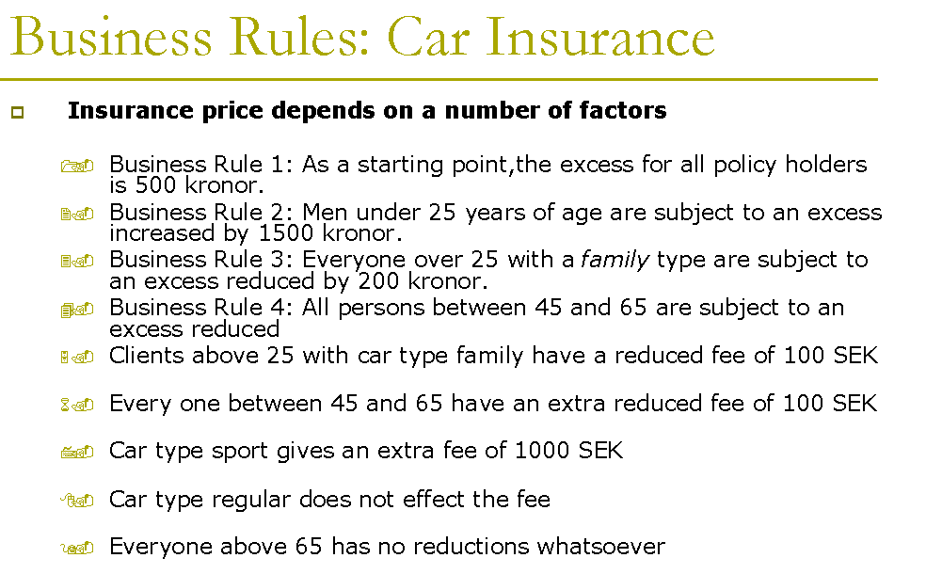
Make a Decision Tree?

Slide 66
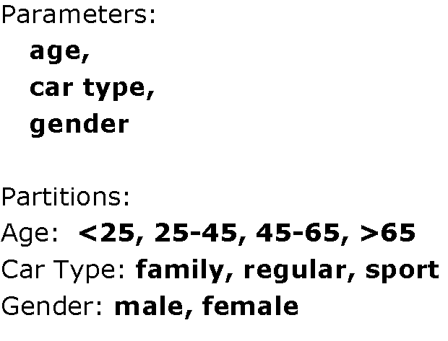
Identify Parameters

Slide 67
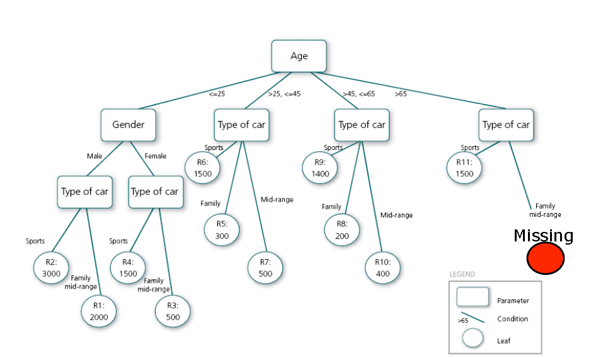
Decision Tree

Slide 68
Decision Tree
Mary is a manager of a gadget factory. Her factory has been quite successful the past three years. She is wondering whether or not it is a good idea to expand her factory this year. The cost to expand her factory is $1.5M. If she does nothing and the economy stays good and people continue to buy lots of gadgets she expects $3M in revenue; while only $1M if the economy is bad.
If she expands the factory, she expects to receive $6M if economy is good and $2M if economy is bad.
She also assumes that there is a 40% chance of a good economy and a 60% chance of a bad economy.
Draw a Decision Tree showing these choices.

Slide 69
Decision Tree
Banana Computer Company manufactures memory chips in batches of ten chips. From past experience, Banana knows that 80% of all batches contain 10% (1 out of 10) defective chips, and 20% of all batches contain 50% (5 out of 10) defective chips. If a good (that is, 10% defective) batch of chips is sent on to the next stage of production, processing costs of $1000 are incurred, and if a bad batch (50% defective) is sent on to the next stage of production, processing costs of $4000 are incurred. Banana also has the option of reworking a batch at a cost of $1000 before sending it to the next stage of production. A reworked batch is sure to be a good batch.
Develop a decision tree for this problem and use it to determine a policy for minimizing Banana’s expected total cost per batch.

Slide 70
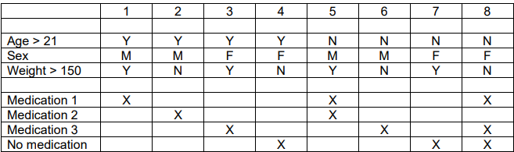
Decision Table?
Decision Table is just a tabular representation of all conditions and actions. Decision Trees are always used whenever the processing logic is very complicated and involves multiple conditions.

Slide 71
Decision Table ( Example)
The Swell Store employs a number of salespeople to sell a variety of items. Most of these salespeople earn their income from a commission, paid on the items they sell, but a few are salary-plus-commission employees; that is, they receive a fixed salary, regardless of the quantity or type of items they sell, plus a commission on certain items. The Swell Store sells several different lines of merchandise, some of which are known as standard items (a can of tomato soup, for example) because they are widespread and do not require any creative sales techniques; in addition, there are bonus items that are highly profitable but difficult to sell (a gold-plated, diamond-studded Cadillac, perhaps). The standard and bonus items generally represent the low and high ends of the price spectrum, sandwiching a greater number of items in the middle of the spectrum.

Slide 72
Decision Table ( Example)
Customers, also, are categorized. Some are known as regulars, because they do business so often that no creative selling is required. Most of the customers, however, do a small amount of business at the Swell Store, and are likely to walk in right off the street, buy something, and then disappear forever.
The management's commission policy is as follows: If a non-salaried employee sells an item that is neither standard nor bonus to someone other than a regular customer, he receives a 10 percent commission, unless the item costs more than $10,000, in which case the commission is 5 percent. For all salespeople, if a standard item is sold, or if any item is sold to a regular customer, no commission is given. If a salaried salesperson sells a bonus item, he receives a 5 percent commission, unless the item sells for more than $1,000, in which case he receives a flat $25 commission. If a non-salaried salesman sells a bonus item to someone other than a regular customer, he receives a 10% commission, unless the item sells for more than $1,000, in which case he receives a flat commission of $75.

Slide 73
Difference b/w Decision Table and Decision Tree
1. | Decision Tables are a tabular representation of conditions and actions. | Decision Trees are a graphical representation of every possible outcome of a decision.
2. | We can derive a decision table from the decision tree. | We can not derive a decision tree from the decision table.
3. | It helps to clarify the criteria. | It helps to take into account the possible relevant outcomes of the decision.
4. | In Decision Tables, we can include more than one ‘or’ condition. | In Decision Trees, we can not include more than one ‘or’ condition.
5. | It is used when there are small number of properties. | It is used when there are more number of properties.
6. | It is used for simple logic only. | It can be used for complex logic as well.
7. | It is constructed of rows and tables. | It is constructed of branches and nodes.

Slide 74
papers
The Role of Use Cases in Requirements and Analysis Modeling
Study on IT tools to assist the development of Chemical Safety Reports
USE-CASE MODEL: WRITING REQUIREMENTS IN CONTEXT
Driving Non-Functional Requirements to Use Cases and Scenarios

